Slide 1
DAY 2 - Getting Started
Yii2 Introduction

Slide 2
Setup Environment
Day 2 - Getting Started

Slide 3




Preparation

Slide 4

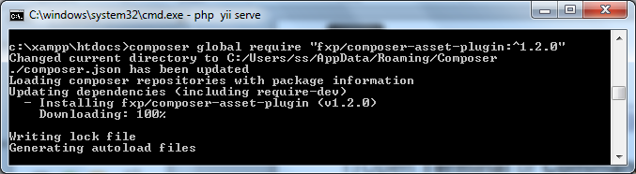
Installing Yii2 Application via Terminal
STEP 1
on
Open Terminal or Command Prompt
Find the BEST location to store Yii2 project (Use cd command)
In your command prompt, enter
composer global require "fxp/composer-asset-plugin:^1.2.0“

Slide 5
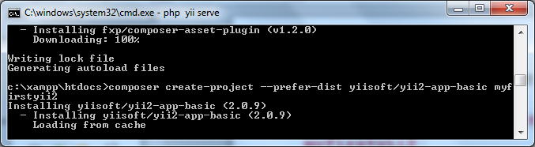
4) Then, download Yii2 package… taip
composer create-project --prefer-dist yiisoft/yii2-app-basic myfirstyii2

Slide 6
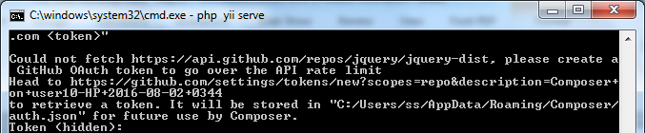
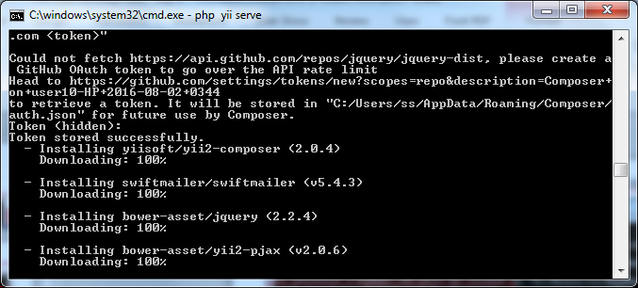
Kalau sistem minta token… contoh mcm kat bawah…
Cara dapatkan token…
Buka https://github.com > settings > personal access tokens > generate new tokens > discription : new ; tick semua ; klik ‘generate token’; copy token yg dia bagi…
Buka cmd semula, paste dekat ruangan Token (hidden)… ENTER…

Slide 7

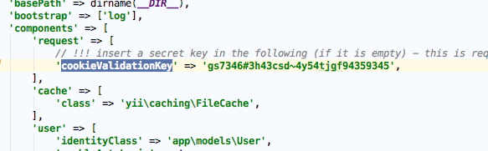
Installing Yii2 Application from an Archive File
STEP 2
on
Open link www.yiiframework.com/download/
Click Yii 2 with basic application template to start download
Extract basic folder to the BEST location to store Yii2 project
Rename basic folder to myfirstyii2
Locate web.php in folder config and fill in cookieValidationKey
Masukkan ape2 je cookie…

Slide 8
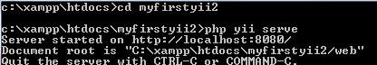
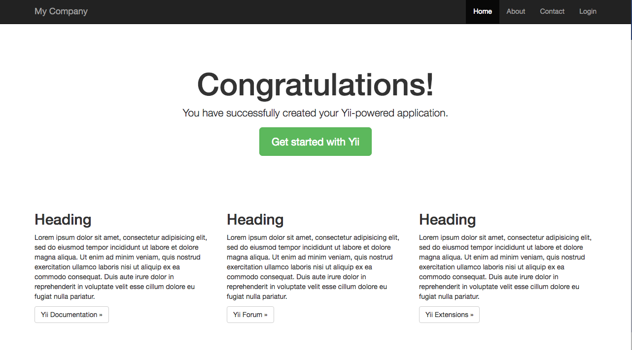
Run Your Yii2 App for the First Time
STEP 3
1) Type “cd <your project destination>” and enter Enter the command below and Run php yii serve
2) Open http://localhost:8080 on browser, nnti akan keluar… mean php yii kite berjaya install…

Slide 9
Setup Database Connection
STEP 4
Notes:
First, you need to run XAMPP. Use HeidiSQL to create your first Database.

Slide 10
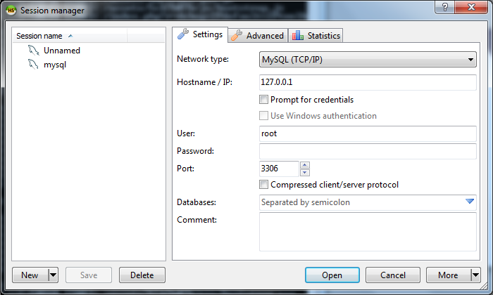
Buka software HeidiSQL
new – rename mysql - open

Slide 11
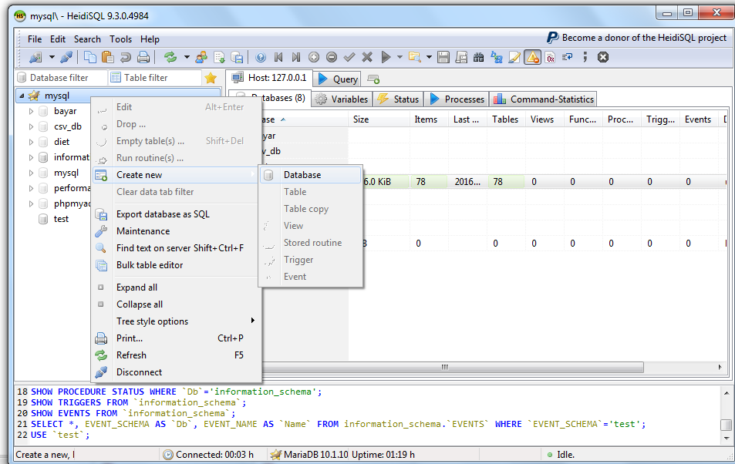
Create new dbase… namakan dbase : dbmuar

Slide 12
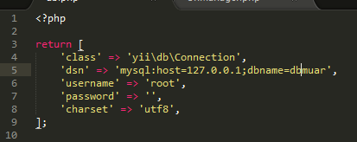
Configure Database Connection
Buka sublime semula… ikut step dibawah
Open db.php inside config folder
Modify the code as follow
return [
'class' => 'yii\db\Connection',
'dsn' => 'mysql:host=127.0.0.1;dbname=dbmuar',
'username' => 'root',
'password' => '',
'charset' => 'utf8',
];
Masukkan nama dbase yg kite buat kat heidi tadi…

Slide 13
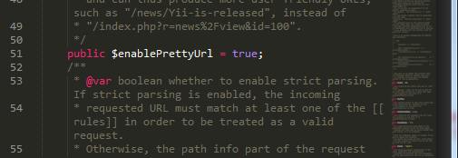
Enable prettyURL
Dalam sublime, Buka…..
Open inside /vendor/yiisoft/yii2/web/ UrlManager.php. Change the false to true

Slide 14
Create .htaccess
Dalam sublime, create file…..
This will allow for prettyURL to work. Create .htaccess inside web folder.
<IfModule mod_rewrite.c>
RewriteEngine on
# If a directory or a file exists, use it directly
RewriteCond %{REQUEST_FILENAME} !-f
RewriteCond %{REQUEST_FILENAME} !-d
# Otherwise forward it to index.php
RewriteRule . index.php
</IfModule>
Copy command n create file .htaccess

Slide 15
CREATE DATABASE DALAM HEIDISQL
Notes:
Bootstrap adalah

Slide 16
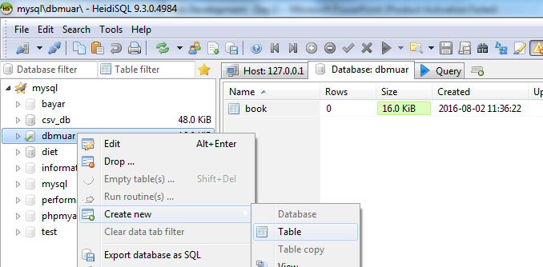
1) Create new table : dbmuar > create new > table..
on
Notes:
Defining Attributes

Slide 17
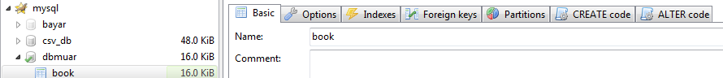
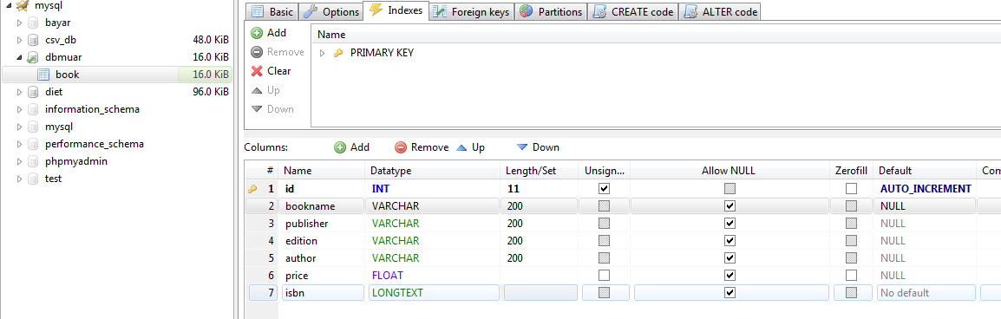
2) Basic name : book 3) Insert column Index setting sepertimana dibawah

Slide 18
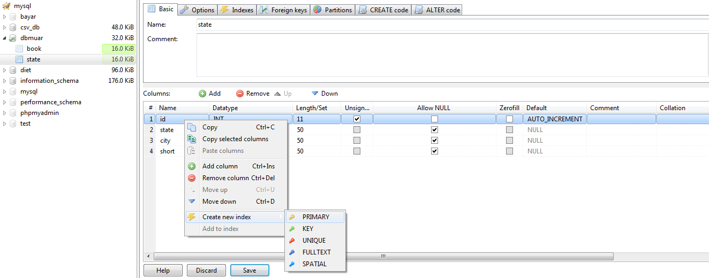
4) Cara buat primary key

Slide 19
CREATE MODEL
Notes:
Bootstrap adalah

Slide 20
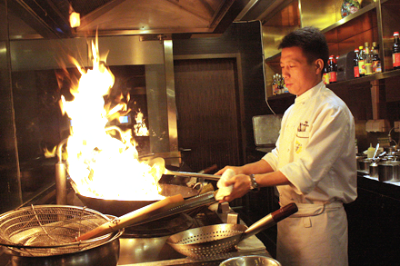
Model
Attribute
Validation Rules
Create a new php file inside Model folder and name it Book.
Object representing business data, rules and logic

Slide 21
on
buka folber myfirstyii2.php> models > create new file > book.php
<?php
namespace app\models;
use yii\base\Model;
class book extends Model{
function attributeLabels()
{
return ["bookname" => "Introduction to Yii2 Programming", //Assign Attribute
"publisher" => "Pearson", //Assign Attribute
"edition" => "Ninth Edition", //Assign Attribute
"author" => "Y.Daniel Liang", //Assign Attribute
"price" => 118.00]; //Assign Attribute
}
public function rules()
{
return [
[['bookname', 'publisher', 'author', 'price'], 'required']
];
}
}
?>
*mesti sama dengan nama database ‘book’
Copy command n create file book.php
Command utk validation rule

Slide 22
CREATE VIEW
Notes:
Bootstrap adalah

Slide 23
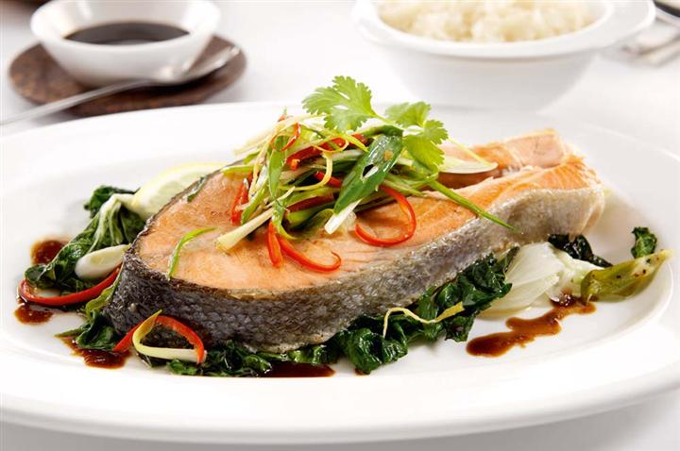
View
Creating View
Create a new php file inside Model folder and name it Book.
Presenting code in User Interface

Slide 24
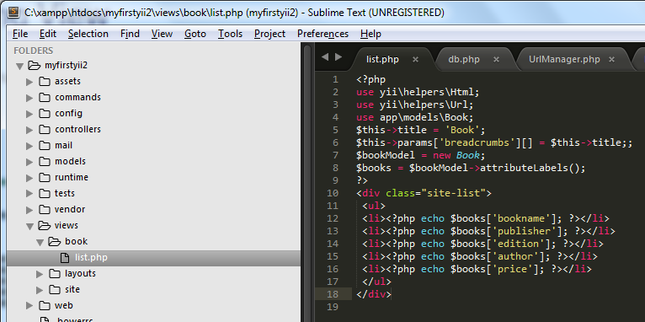
on
create folder book dalam : C:\xampp\htdocs\myfirstyii2\views\book
Create file list.php. Copy cording….
<?php
use yii\helpers\Html;
use yii\helpers\Url;
use app\models\book;
$this->title = 'Book';
$this->params['breadcrumbs'][] = $this->title;;
$bookModel = new Book;
$books = $bookModel->attributeLabels();
?>
<div class="site-list">
<ul>
<li><?php echo $books['bookname']; ?></li>
<li><?php echo $books['publisher']; ?></li>
<li><?php echo $books['edition']; ?></li>
<li><?php echo $books['author']; ?></li>
<li><?php echo $books['price']; ?></li>
</ul>
</div>
Copy command n create file list.php
*mesti sama dengan nama database ‘book’

Slide 25
CREATE CONTROLLER
Notes:
Bootstrap adalah

Slide 26
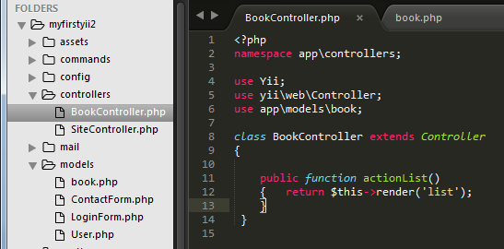
on
Create file BookController.php dalam folder controllers. Copy cording….
Nama mesti sama
<?php
namespace app\controllers;
use Yii;
use yii\web\Controller;
use app\models\book;
class BookController extends Controller
{
public function actionList()
{ return $this->render('list');
}
}
Copy command n create file BookController.php

Slide 27
Running program
Notes:
Bootstrap adalah

Slide 28
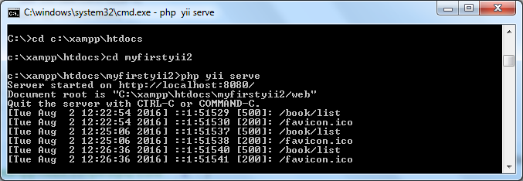
Cara nak run sistem…..
Run cmd untuk connection yii
C:\xampp\htdocs\myfirstyii2 php yii serve…ENTER

Slide 29
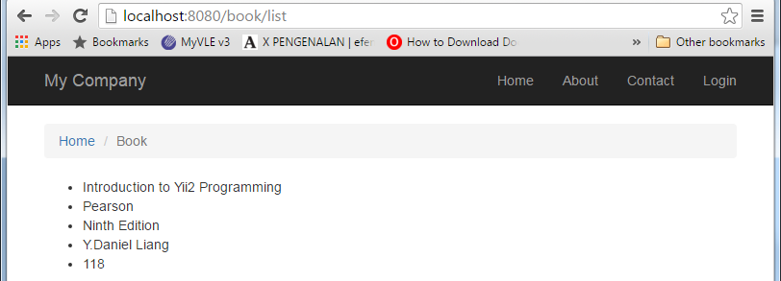
Cara nak display sistem…..

